Slide 1
Group 5 - Petit Website Project
Sprint Cycle 2

Slide 2
Team members
1.Brian Le (Bao Le) - Frontend Developer
Learn and update code in React Js for homepage, created confirmation appointment page and cancel appointment and About page.
3.G (Guillermo Clara) - Full-Stack Developer
Changed some structures in database tables to improve optimization. Created the different API endpoints used to feed the client application
5.Jisoo Park - Backend Developer
Created and managed data in Database Tables. Configures settings and established connection between React through Django. Created Documents for project presentation.
2.Aleeza Iftikhar- Frontend Developer
Learning and Implementing code in React js, Created Business dashboard page and Routes to pages to View appointments, Edit employees, and Manage services.
4. Jennie Vu (Nga Vu) - Frontend Developer
Create a web page dedicated to appointment booking by React. Implement UI components. Create a Dropdown box for services and employee selections. Create Date picker components. Create Toggle to show the available time selected

Slide 3
Project Backlog SC 2
Create a coherent About Page (Complete)
Create an initial Site Map
Create views (Event Handlers) (Complete)
Done Button for creating business (Will trigger event handler)
Create a web page dedicated to appointment booking
Create business dashboard (In Progress)
Create routes for employees, services, view appointments pages in business dashboard (Complete)
Create appointment confirmation/cancellation page
CORS setup

Slide 4
Challenges & Lessons Learned
Challenges:
Confusion in Directory Establishment
Learning and Implementing code in React.
Cross Origin Resource Sharing in API
Lessons Learned
Learned how to utilize Django more coherently
Improved communication in terms of managing GITHub pulls and pushes

Slide 5
Project Backlog SC 3
Create a method to create and send a unique link after the user clicks booking the appointment button
Create a post request handler in this page so that when the appointment cancel button is clicked it will change the db.
Finalize Business dashboard and create Settings page
Update pages managing employees and services
Update ‘view appointments’ page in business dashboard to show list of upcoming/previous appointments.
Authentication System

Slide 6
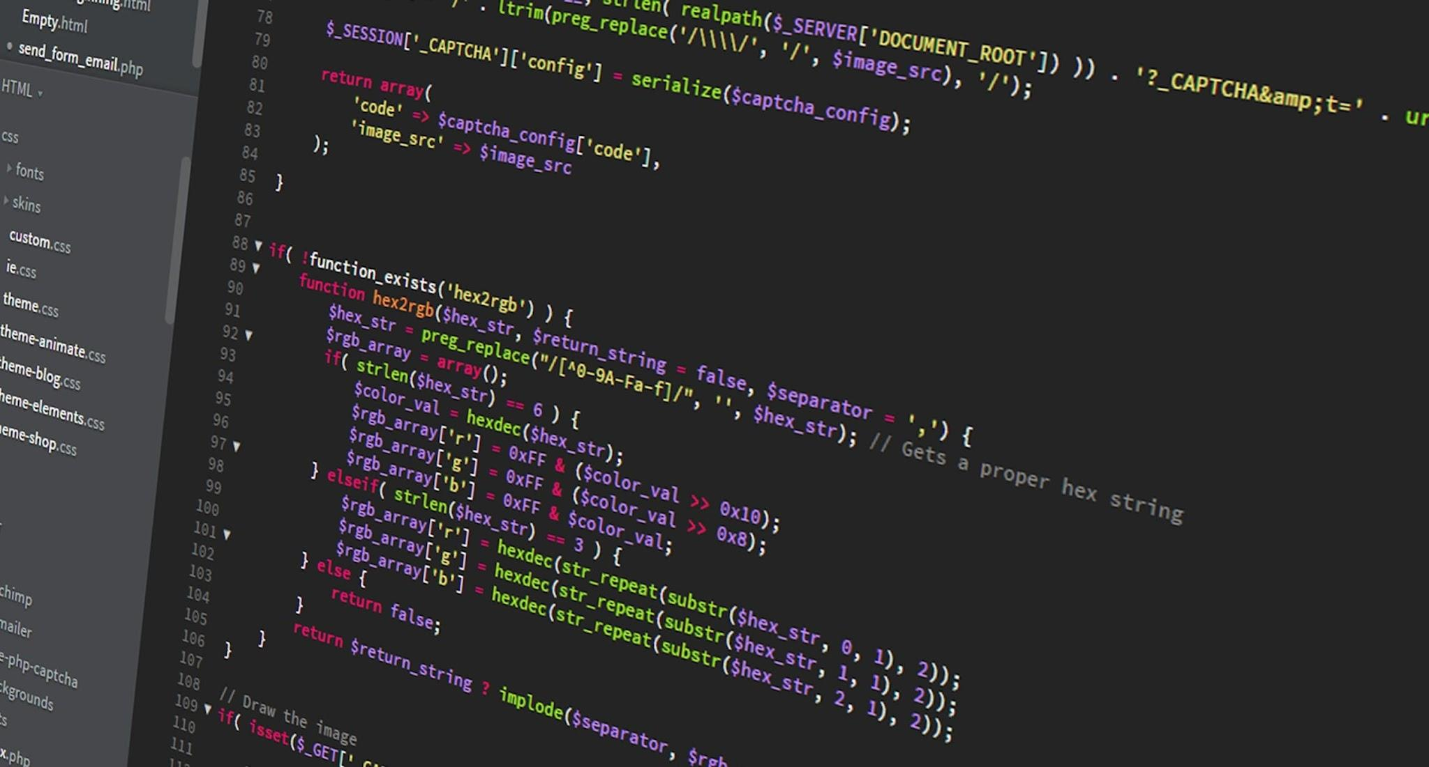
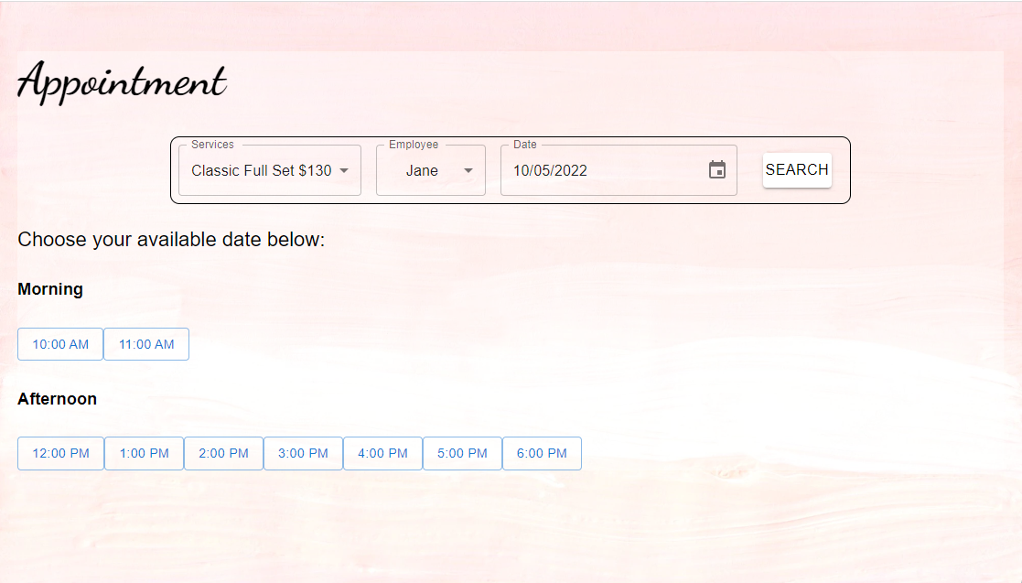
Development Efforts
Development Efforts

Slide 7
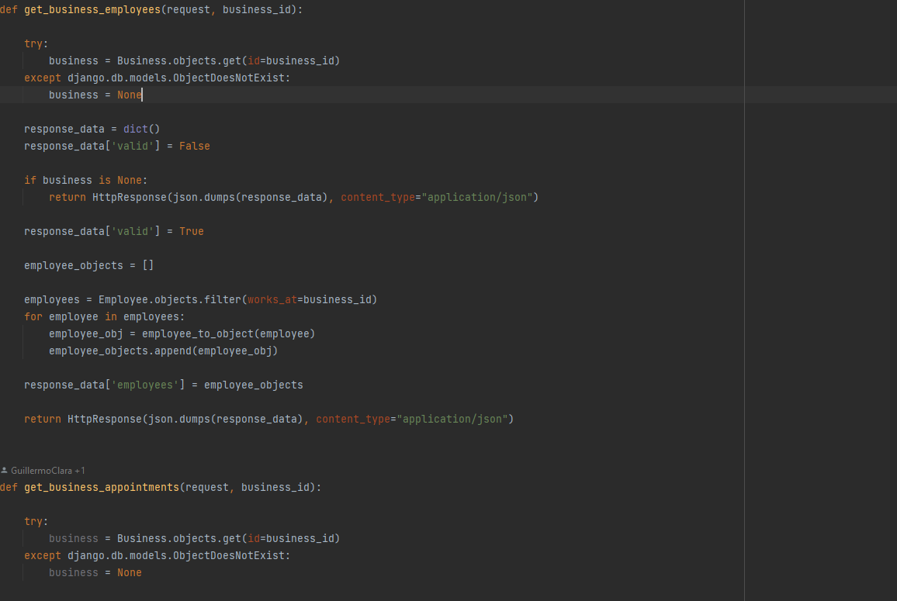
Development Efforts

